Slide 1
Transition from University to Work: Dynamic Relationships between Career Planning, Self-efficacy, and Worry
Anne-Kathrin Kleine, Antje Schmitt, & Anita C. Keller
University of Groningen

Slide 2




Career-related worries during pre-graduation phase:
Insecurity about future employment
(Koen et al., 2012; Leach, 2017)
Labor market myths
(Ball, 2018)
Career construction theory (Savickas, 2005)
Adapting as a process of performing actions that address changing conditions directly
Career planning as a means to deal with career-related worries (see, e.g., Stringer et al., 2011)
Notes:
Stringer, K., Kerpelman, J., & Skorikov, V. (2011):
Results also suggested that career planning and decision-making preceded career confidence

Slide 3
Career planning (Gould, 1979)
the extent to which career plans exist,
how frequently career plans are changed,
how clear the plans are, and
whether or not a strategy exists for achieving career goals

Slide 4
H1: Career planning leads to a decrease in career-related worries during the pre-graduation phase
Career planning
Career-related worry
-

Slide 5






Task avoidance theory (e.g., Ferrari et al., 1995):
(Irrational) fears and self-criticism lead to task avoidance
Worry affects the temporal focus on outcomes (Worthy et al., 2014)
preference for immediate over delayed rewards
Affect‐as‐information model (Clore et al., 2001):
Worry as a motivator to engage in career planning (e.g., Sweeny & Dooley, 2017)

Slide 6
H2a: Career-related worry leads to a decrease in career planning during the pre-graduation phase
H2b: Career-related worry leads to an increase in career planning during the pre-graduation phase
Career-related worry
-
Career planning
+

Slide 7

Career construction theory
(Savickas, 2005)
Career-preparatory actions (adapting) as a source of a sense of mastery
Gaining self-efficacy by engaging in career-preparatory behavior (DelCorso, 2011)

Slide 8
Social cognitive career theory
(e.g., Lent, Brown, and Hackett 1994):
Self-efficacy as a predictor of a person’s engagement in career-preparatory behaviors (e.g., Chung, 2002)

Slide 9
H3: Career planning leads to an increase in self-efficacy during the pre-graduation phase
Career planning
Self-efficacy
+
H4: Self-efficacy leads to an increase in career planning during the pre-graduation phase
Self-efficacy
Career planning
+

Slide 10

Self-efficacy as a predictor of positive affect and well-being (e.g., Bandura, 2000)
Self-efficacy diminishes pre-task anxiety (Stumpf et al., 1987)

Slide 11
H5: Self-efficacy leads to a decrease in career-related worry during the pre-graduation phase
Self-efficacy
Career-related worry
-

Slide 12
The Research Model
Self-efficacy
H4
H5
+
+
-
H3
Career planning
-
H1
Career-related worry
-
H2
+

Slide 13



Time points:
T1: Three months before graduation
T2: six weeks before graduation
Sample:
300 British students during the pre-graduation phase
64% female
Mean age = 22.8
27.6% found a job at T2
Measures:
Career planning (Gould 1979)
Self-efficacy (Chen et al., 2001)
Career-related worry (WDQ-R, Rijsoort et al., 1999)

Slide 14

Latent Change Score Modelling (McArdle & Hamagami, 2001; McArdle, 2009)
Detect differences in the patterns of individual changes
Examination of interrelated processes
Change score Δ = Change for one individual from t to t+x
Pre-graduation phase as a phase of change (e.g., triggered by active engagement in career-preparatory behavior)

Slide 15
Reliabilities:
Cronbach’s alpha between .88 (t1 self-efficacy) and .91 (t1 career planning)
CFA:
Best fit for three-factor model
Measurement invariance:
Strong factorial invariance established (change in fit for any of the relevant fit measures < .003)

Slide 16
Bivariate Latent Change Score Model
Mean change
Self-feedback
Coupling effect
Example Plot: Bivariate Latent Change Score Model Career Planning - Worry

Slide 17
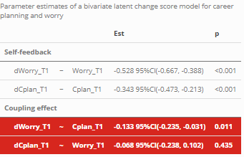
Bivariate Latent Change Score Model Career Planning - Worry
Constraining coupling effect of worry to zero → no change in model fit (p = .436)
Constraining coupling effect of career planning to zero → change in model fit (p = .001)

Slide 18


Career planning
-
H1
Career-related worry
-
H2
+

Slide 19
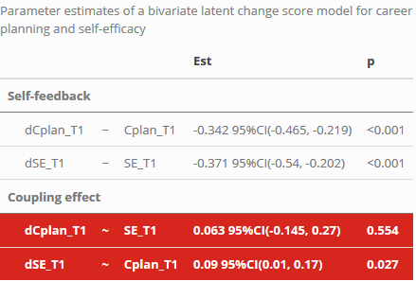
Bivariate Latent Change Score Model Career Planning – Self-efficacy
Constraining coupling effect of self-efficacy to zero → no change in model fit (p = .552)
Constraining coupling effect of career planning to zero → change in model fit (p = .015)

Slide 20
Career planning
+
H3
Self-efficacy
+
H4

Slide 21
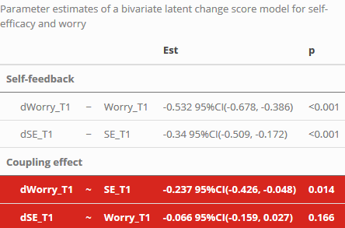
Bivariate Latent Change Score Model Self-efficacy - Worry
Constraining coupling effect of worry to zero → no change in model fit (p = .156)
Constraining coupling effect of self-efficacy to zero → change in model fit (p = .007)

Slide 22
Self-efficacy
Career-related worry
-
H5

Slide 23
The Research Model
Self-efficacy
H4
H5
+
+
-
H3
Career planning
-
H1
Career-related worry
-
H2
+

Slide 24
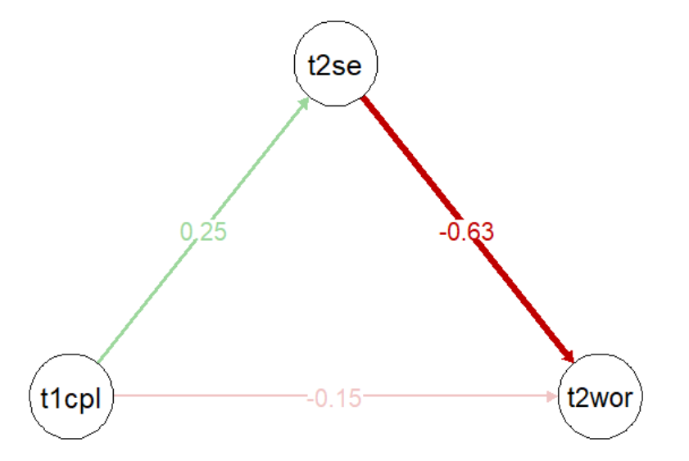
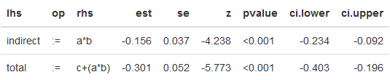
Mediation analysis

Slide 25

Take home message
Career planning during the pre-graduation phase positively influences affective (reduced worry) and cognitive (enhanced self-efficacy) outcomes
Career planning as a buffer against uncertainty and worry
Worried graduates do not tend to decrease their level of planning
Self-efficacy seems to convey the effect of career planning on career-related worry

Slide 26
References
Ball, Charlie. 2018. “Graduate labour market myths.” In Graduate Careers in Context - Research, Policy, and Practice, edited by Ciaran Burke and Fiona Christie. Taylor & Francis.
Ballas, D., and D. Dorling. 2007. “Measuring the impact of major life events upon happiness.” International Journal of Epidemiology 36 (6): 1244–52. https://doi.org/10.1093/ije/dym182.
Bandura, Albert. 2000. “Self-efficacy: The foundation of agency.” In Control of Human Behavior, Mental Processes, and Consciousness, edited by Walter J. Perrig and Alexander Grob, 16–31. Psychology Press.
Chen, Gilad, Stanley M. Gully, and Dov Eden. 2001. “Validation of a New General Self-Efficacy Scale.” Organizational Research Methods 4 (1): 62–83. https://doi.org/10.1177/109442810141004.
Chung, Y. B. 2002. “Career Decision-Making Self-Efficacy and Career Commitment: Gender and Ethnic Differences Among College Students.” Journal of Career Development 28: 277–84. https://doi.org/https://doi.org/10.1023/A:1015146122546.
Clore, G. L., K. Gasper, and E. Garvin. 2001. “Affect as information.” In Handbook of Affect and Social Cognition, edited by J. P. Forgas, 121–44. Mahwah, NJ: Lawrence Erlbaum Associates.
Creed, Peter A., Tracy Fallon, and Michelle Hood. 2009. “The relationship between career adaptability, person and situation variables, and career concerns in young adults.” Journal of Vocational Behavior 74 (2): 219–29. https://doi.org/10.1016/j.jvb.2008.12.004.
Del Corso, Jennifer, and Mark C. Rehfuss. 2011. “The role of narrative in career construction theory.” Journal of Vocational Behavior 79 (2): 334–39. https://doi.org/10.1016/j.jvb.2011.04.003.
Gould, Sam. 1979. “Characteristics of Career Planners in Upwardly Mobile Occupations.” Academy of Management Journal 22 (3): 539–50. https://doi.org/10.5465/255743.
Hirschi, Andreas. 2009. “Career adaptability development in adolescence: Multiple predictors and effect on sense of power and life satisfaction.” Journal of Vocational Behavior 74 (2): 145–55. https://doi.org/10.1016/j.jvb.2009.01.002.
Koen, Jessie, Ute-Christine Klehe, and Annelies E. M. Van Vianen. 2012. “Training career adaptability to facilitate a successful school-to-work transition.” Journal of Vocational Behavior 81 (3): 395–408. https://doi.org/10.1016/j.jvb.2012.10.003.
Leach, Tony. 2017. “‘It seems at the moment my career is dependent on factors outside of my control’: reflections on graduates’ experiences of employment and career enactment in an era of economic uncertainty and austerity.” British Journal of Guidance & Counselling 45 (2): 188–98. https://doi.org/10.1080/03069885.2016.1254724.
Lent, Robert W., Steven D. Brown, and Gail Hackett. 1994. “Toward a Unifying Social Cognitive Theory of Career and Academic Interest, Choice, and Performance.” Journal of Vocational Behavior 45 (1): 79–122. https://doi.org/10.1006/jvbe.1994.1027.
Ng, Thomas W. H., Lillian T. Eby, Kelly L. Sorensen, and Daniel C. Feldman. 2005. “PREDICTORS OF OBJECTIVE AND SUBJECTIVE CAREER SUCCESS: A META-ANALYSIS.” Personnel Psychology 58 (2): 367–408. https://doi.org/10.1111/j.1744-6570.2005.00515.x.
Rijsoort, Stella van, Paul Emmelkamp, and Geert Vervaeke. 1999. “The Penn State Worry Questionnaire and the Worry Domains Questionnaire: structure, reliability and validity.” Clinical Psychology & Psychotherapy 6 (4): 297–307. https://doi.org/10.1002/(SICI)1099-0879(199910)6:4<297::AID-CPP206>3.0.CO;2-E.
Savickas, Mark L. 2005. “The theory and practice of career construction.” In Career Development and Counseling: Putting Theory and Research to Work, edited by Steven D Brown and Robert W Lent, 42–70. New Jersey: John Wiley & Sons.
Skorikov, Vladimir. 2007. “Continuity in adolescent career preparation and its effects on adjustment.” Journal of Vocational Behavior 70 (1): 8–24. https://doi.org/10.1016/j.jvb.2006.04.007.
Stringer, Kate, Jennifer Kerpelman, and Vladimir Skorikov. 2011. “Career preparation: A longitudinal, process-oriented examination.” Journal of Vocational Behavior 79 (1): 158–69. https://doi.org/10.1016/j.jvb.2010.12.012.
Stumpf, Stephen A, Arthur P Brief, and Karen Hartman. 1987. “Self-efficacy expectations and coping with career-related events.” Journal of Vocational Behavior 31 (1): 91–108. https://doi.org/10.1016/0001-8791(87)90037-6.
Sweeny, Kate, and Michael D. Dooley. 2017. “The surprising upsides of worry.” Social and Personality Psychology Compass 11 (4): e12311. https://doi.org/10.1111/spc3.12311.
Worthy, Darrell A., Kaileigh A. Byrne, and Sherecce Fields. 2014. “Effects of emotion on prospection during decision-making.” Frontiers in Psychology 5 (June). https://doi.org/10.3389/fpsyg.2014.00591.

Slide 27
R Code and Presentation
You may access the R code and the presentation via
https://github.com/fastnotfurious/SGM_Amsterdam_Mar20

Slide 28
Appendix
Notes:
Would recommend to add a slide on the measures; sample items

Slide 29
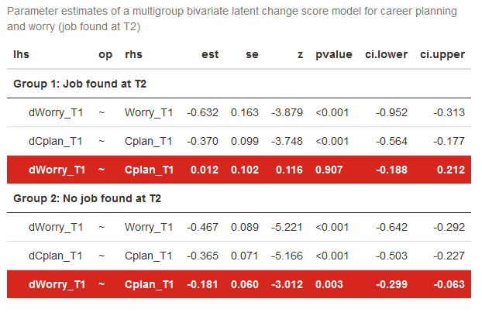
Additional analyses
Multigroup comparison:
Job found at T2 vs. no job found at T2

Slide 30
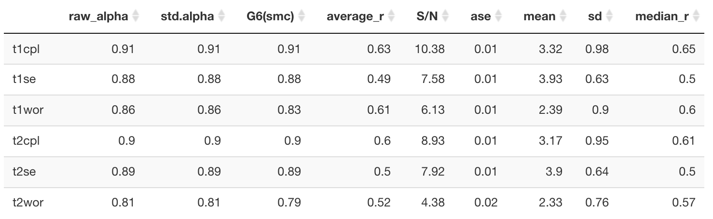
Reliabilities

Slide 31
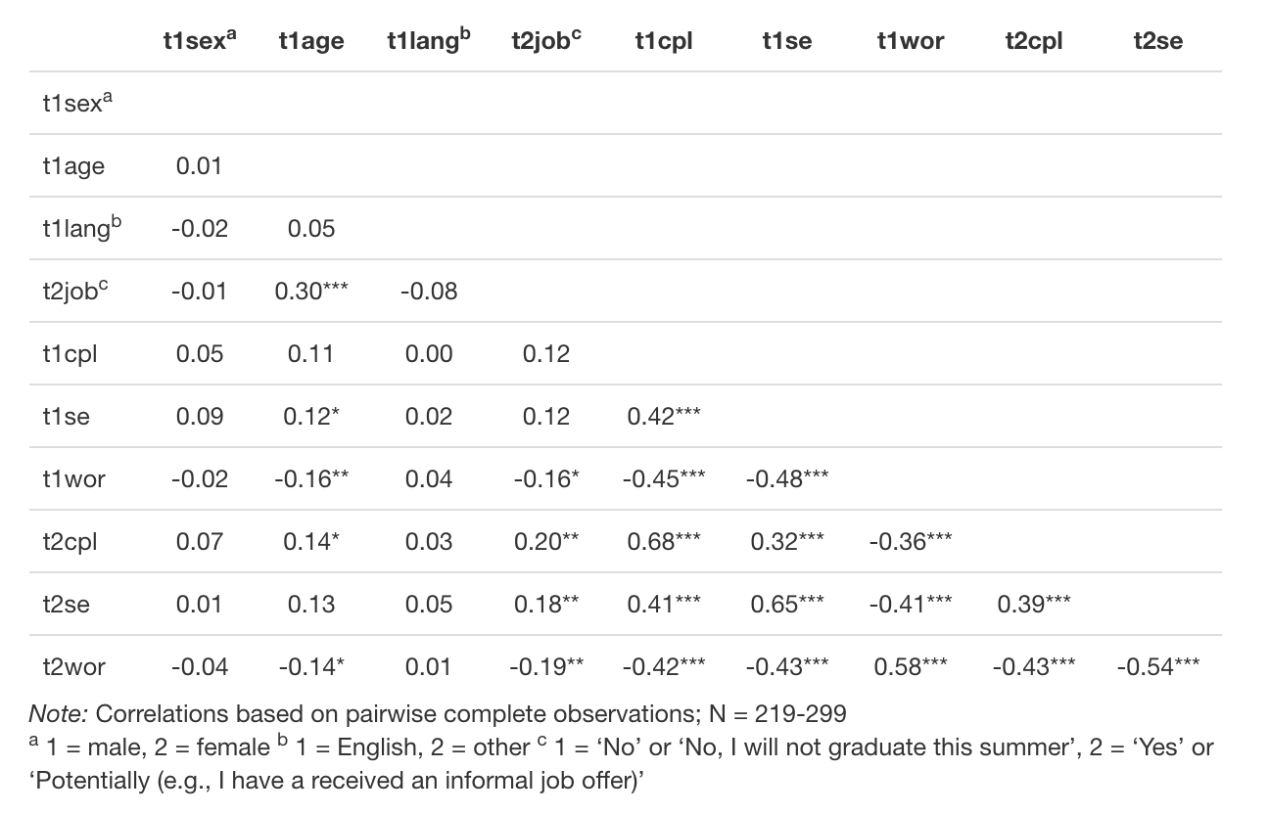
Correlations

Slide 32
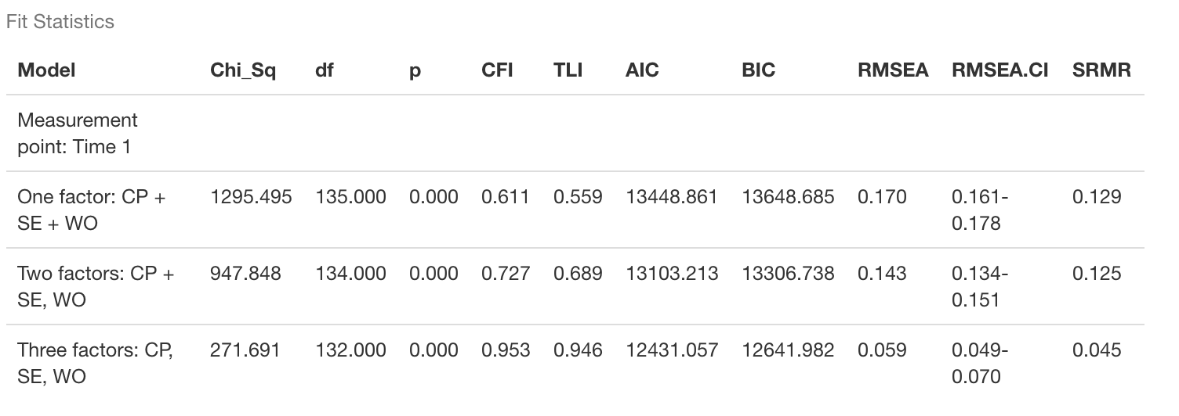
Confirmatory Factor Analyses
Model comparison: One versus two versus three factors

Slide 33
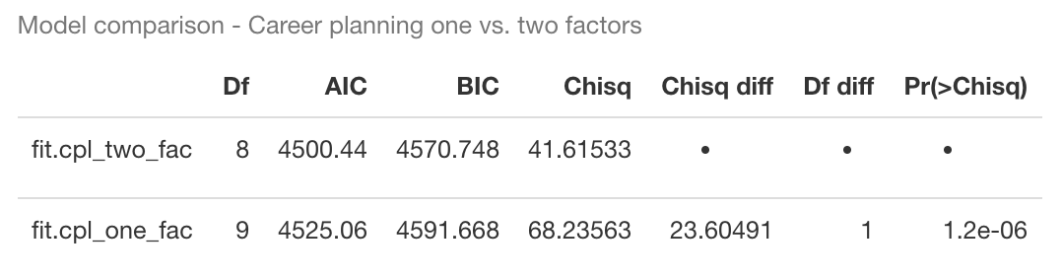
Confirmatory Factor Analyses
“I have not really decided what my career objectives should be yet.” (reverse): Decidedness
“I have a plan for my career.”: Strategy
“I have a strategy for achieving my career goals.”: Strategy
“I know what I need to do to reach my career goals.”: Strategy
“My career objectives are not clear.” (reverse): Decidedness
“I change my career objectives frequently.” (reverse): Decidedness

Slide 34
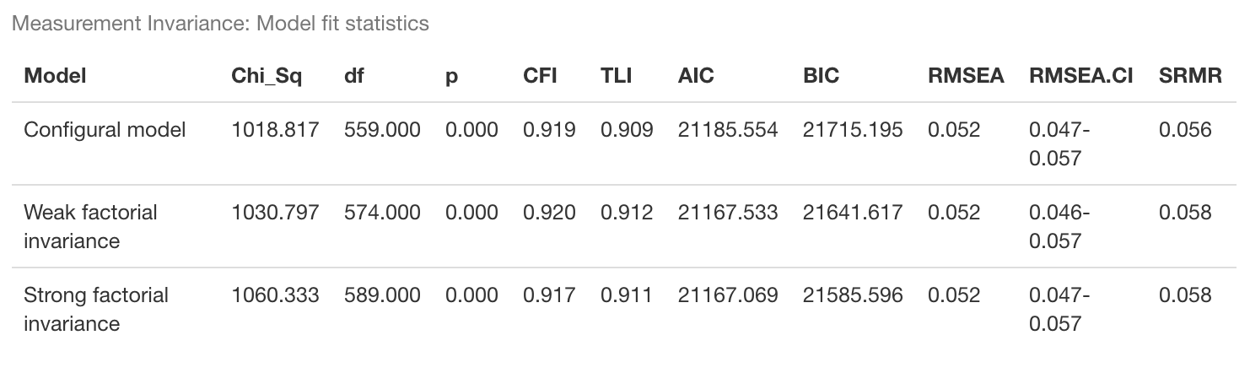
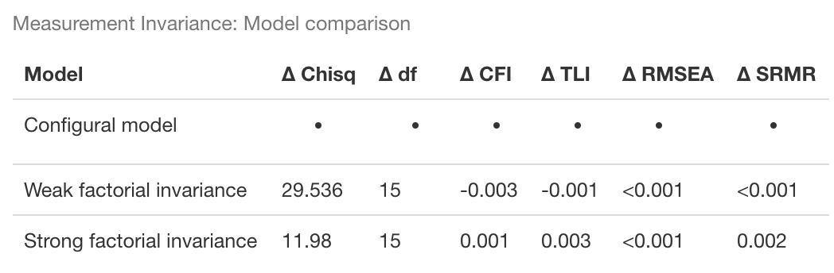
Measurement Invariance

Slide 35
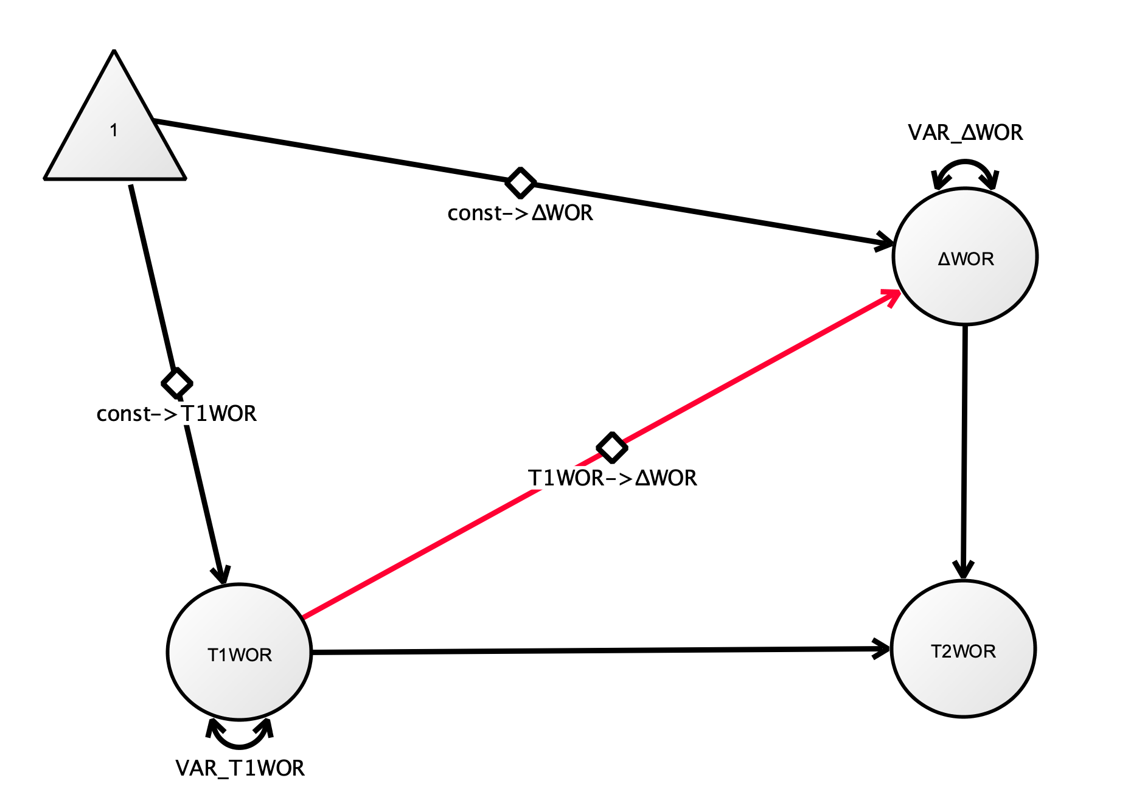

Univariate Latent Change Score Model
 | CPL | SE | WOR
Mean change
Variance of change score
Covariance of initial score with change score
Example Plot: Univariate Latent Change Score Model Worry

Slide 36
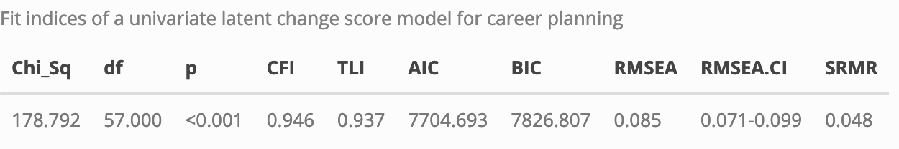
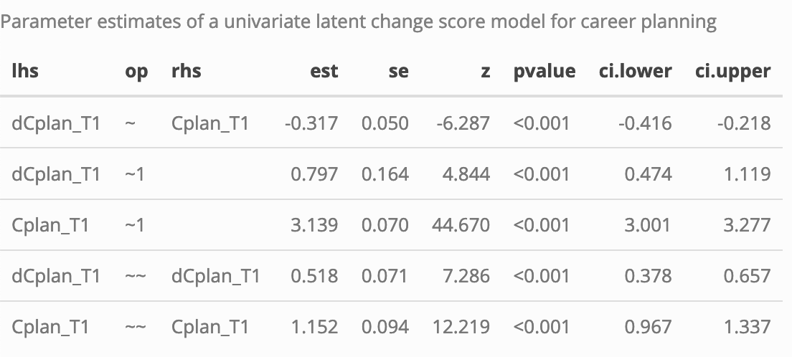
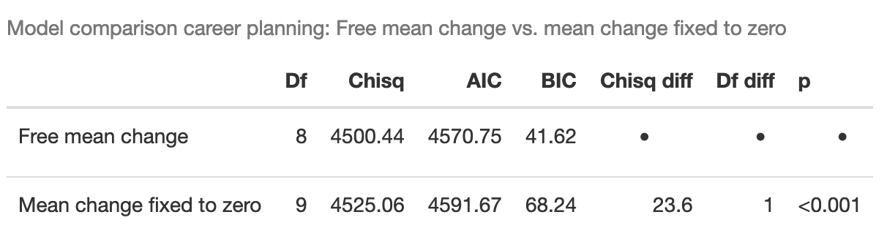
Univariate Latent Change Score Model Career Planning
Overall model fit
Covariance between initial score and change score
Variance change score
Mean change

Slide 37
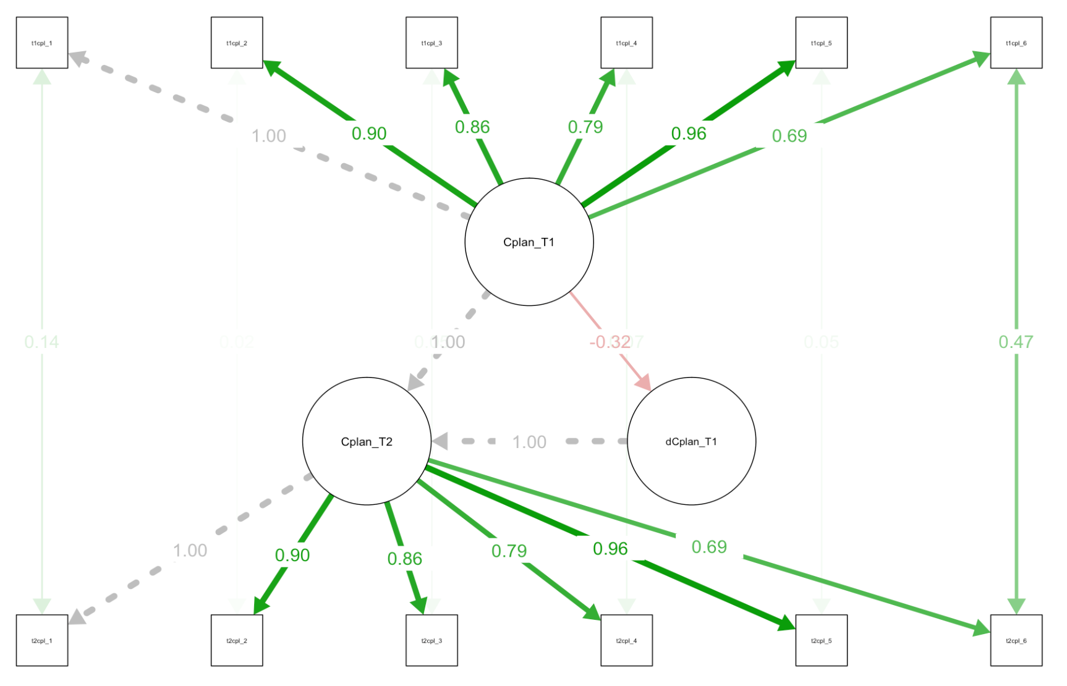
Univariate Latent Change Score Model Career Planning

Slide 38
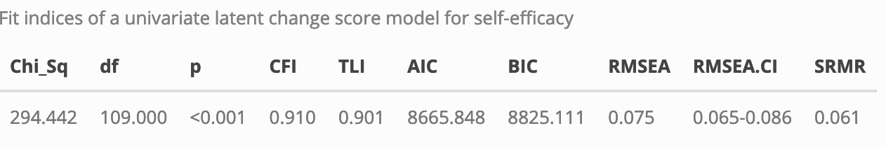
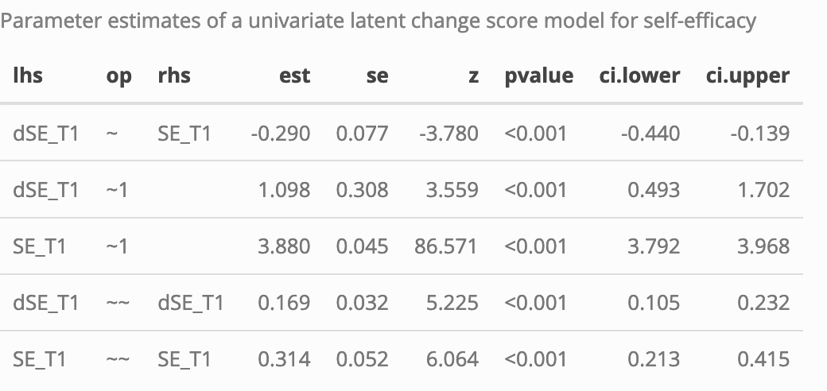
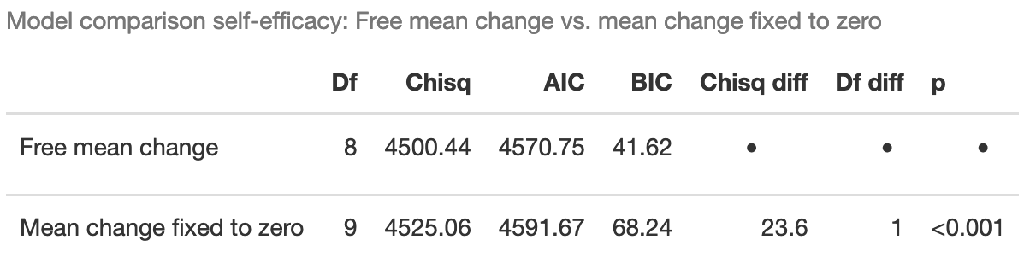
Univariate Latent Change Score Model Self-efficacy

Slide 39
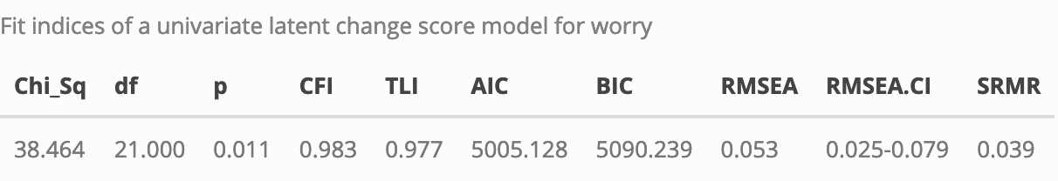
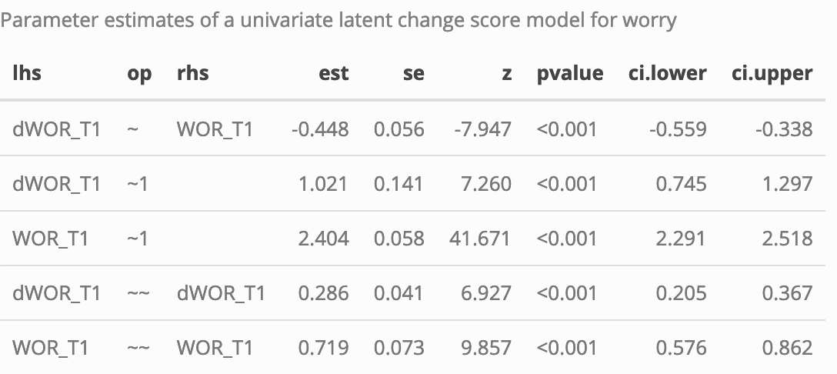
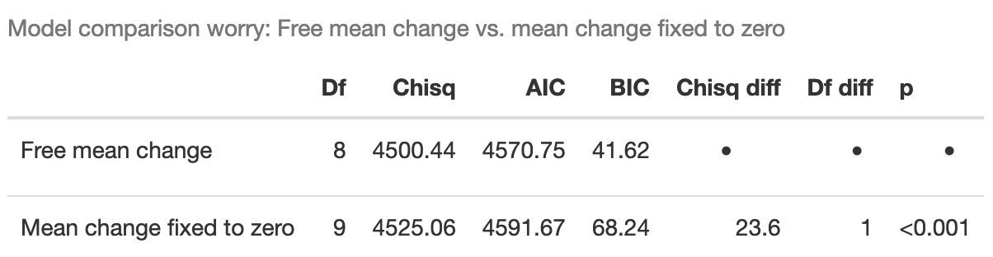
Univariate Latent Change Score Model Career-related Worry

Slide 40
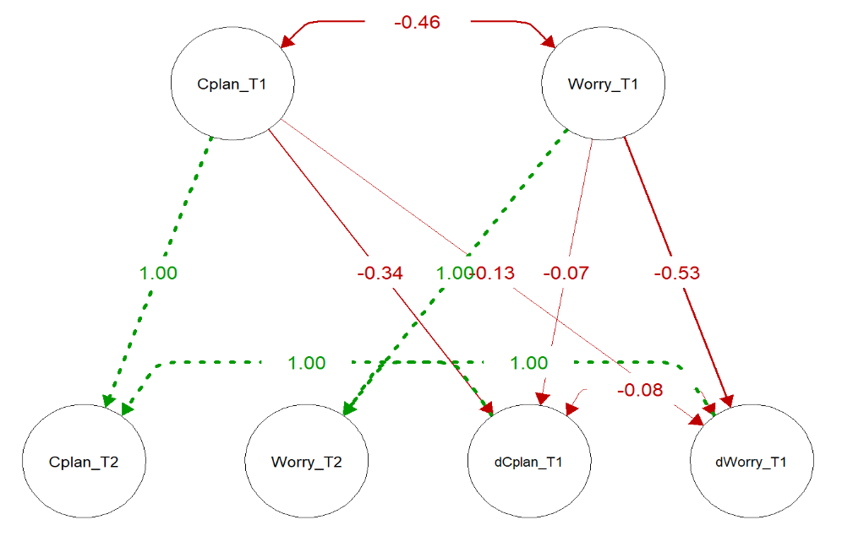
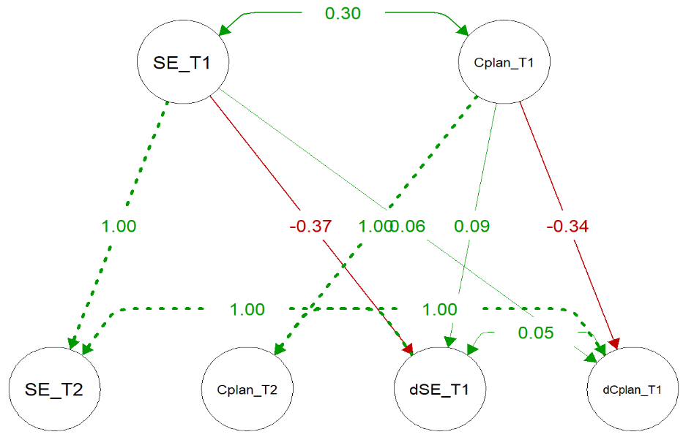
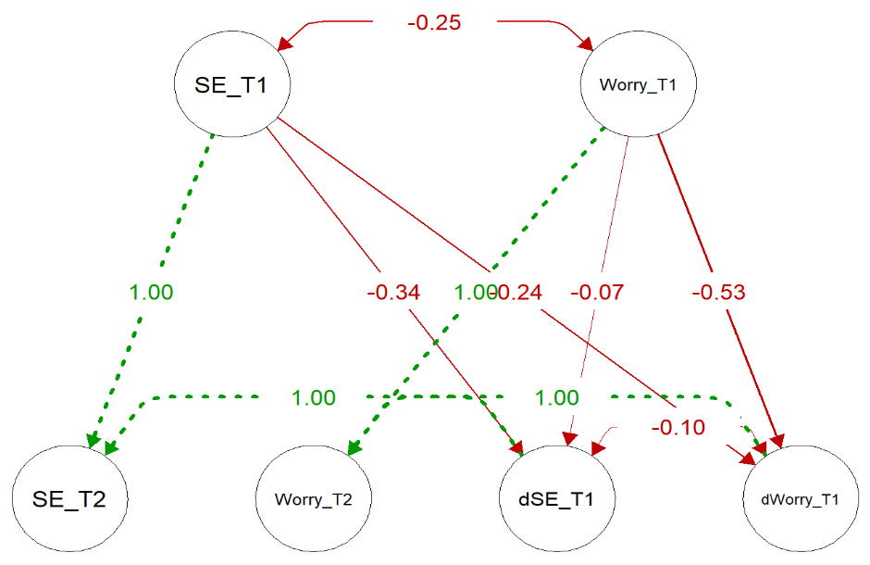
Plots bivariate change score models

Slide 41
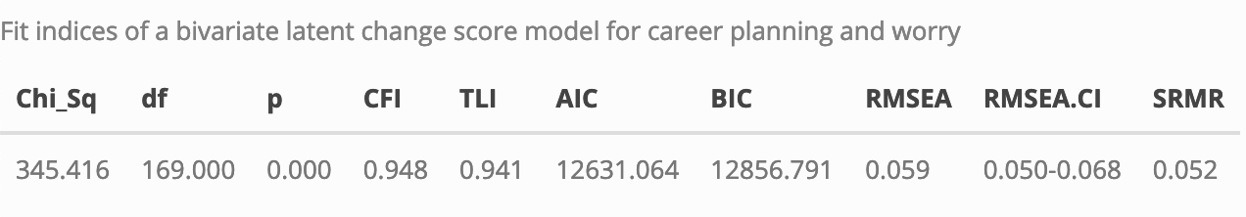
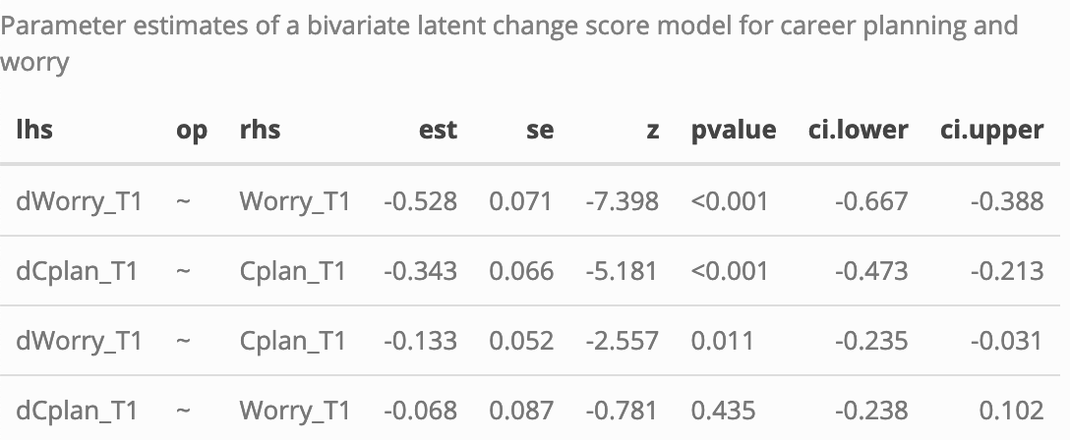
Bivariate Latent Change Score Model Career Planning - Worry

Slide 42
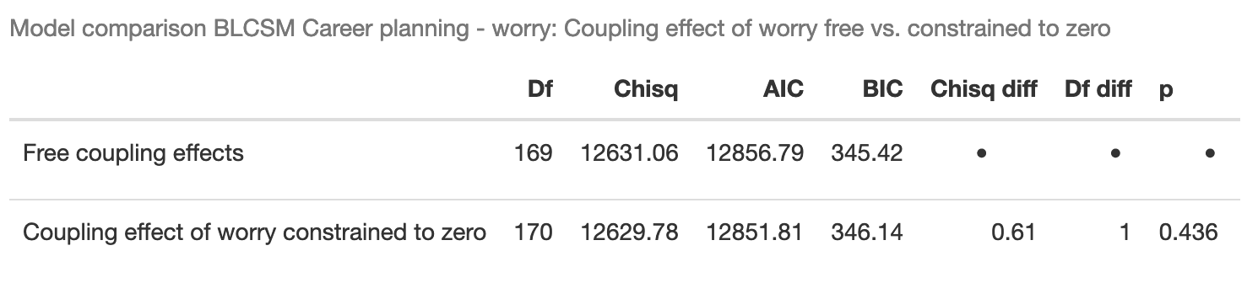
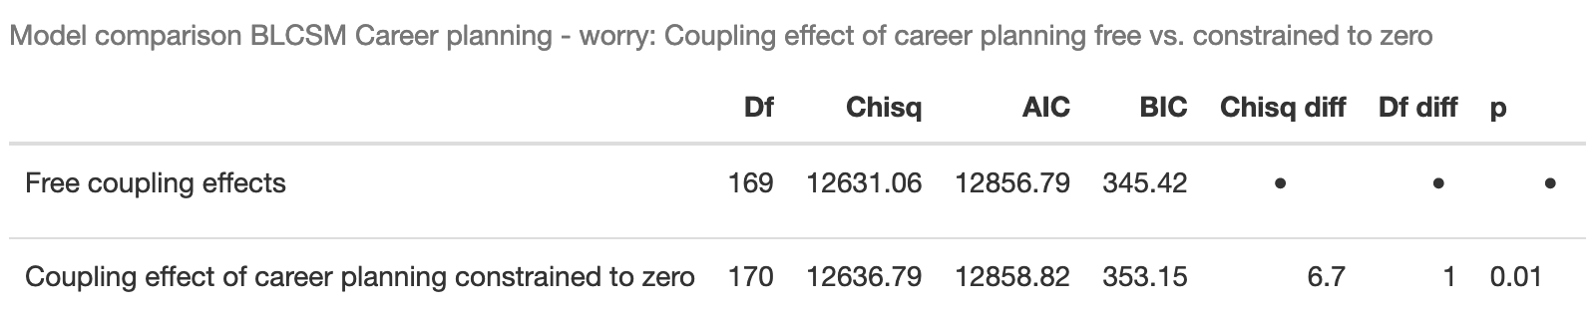
Bivariate Latent Change Score Model Career Planning - Worry
Model comparison: Coupling parameters constrained to zero
H1
H2

Slide 43
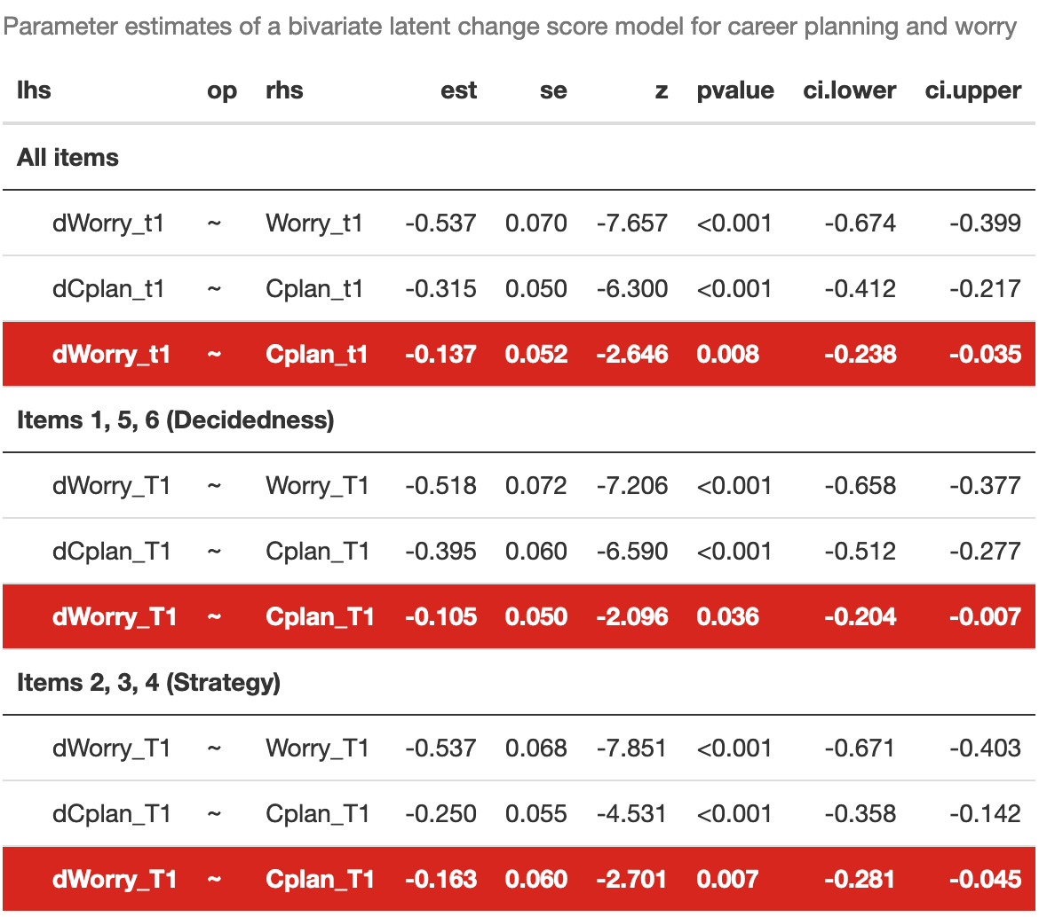
Bivariate Latent Change Score Model Career Planning - Worry
“I have not really decided what my career objectives should be yet.” (reverse): Decidedness
“I have a plan for my career.”: Strategy
“I have a strategy for achieving my career goals.”: Strategy
“I know what I need to do to reach my career goals.”: Strategy
“My career objectives are not clear.” (reverse): Decidedness
“I change my career objectives frequently.” (reverse): Decidedness

Slide 44
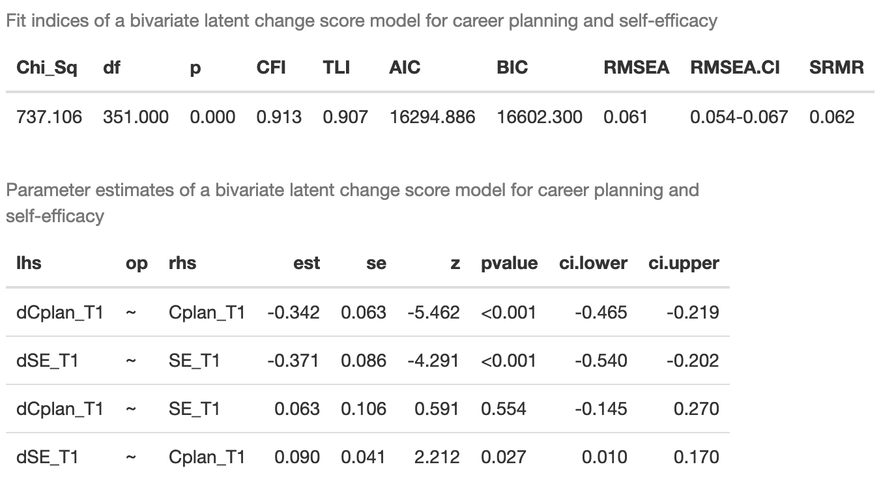
Bivariate Latent Change Score Model Career Planning – Self-efficacy

Slide 45
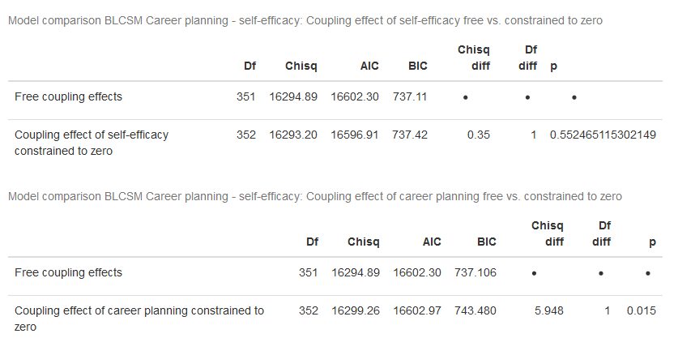
Bivariate Latent Change Score Model Career Planning – Self-efficacy
Model comparison: Coupling parameters constrained to zero
H3
H4

Slide 46
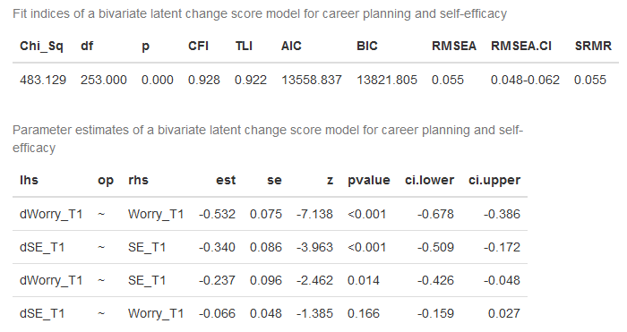
Bivariate Latent Change Score Model Self-efficacy – Worry

Slide 47
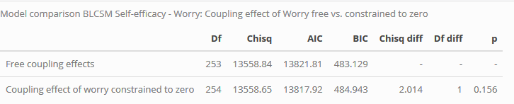
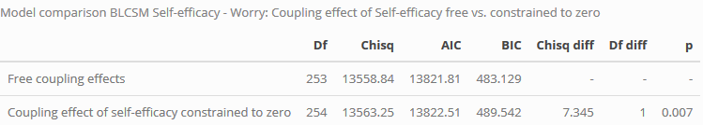
Bivariate Latent Change Score Model Self-efficacy - Worry
Model comparison: Coupling parameters constrained to zero
H5

Slide 48

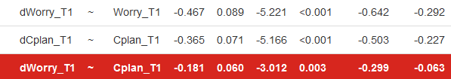
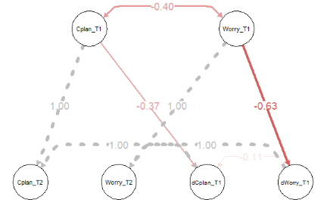
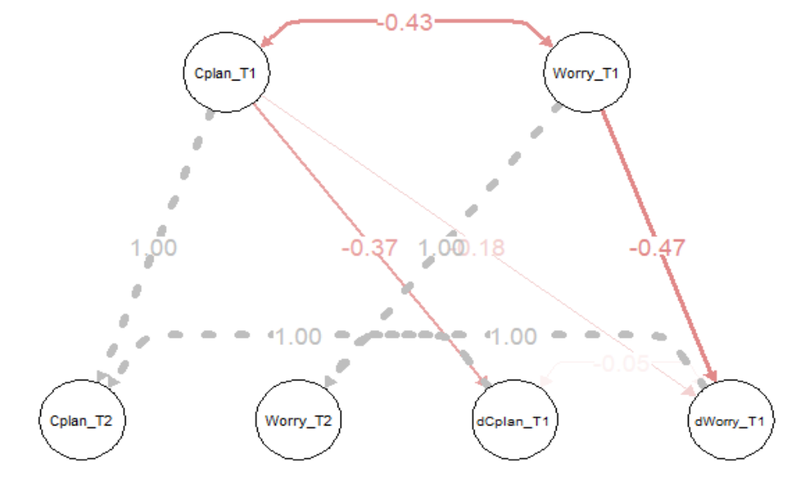
Multigroup Bivariate Latent Change Score Model Career-planning – Worry
Job found at T2 (Group 1) vs. no job found at T2 (Group 2)

Slide 49
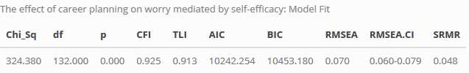
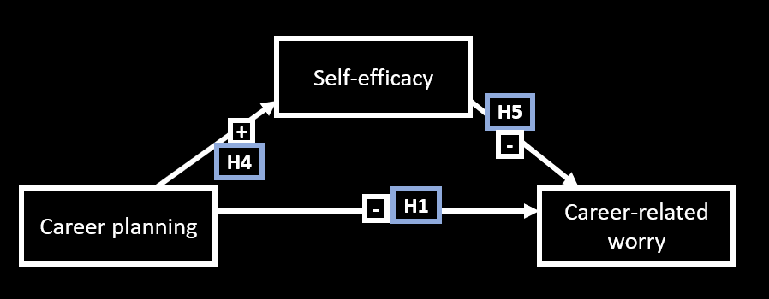
The effect of career planning on worry mediated by self-efficacy

